Slide 1

Software Development Life cycle , Software Process Models: RAD(Rapid Application Development) Model
Presented By:
B.VAMSI
22551A4408
DATA SCIENCE
GIET
Kalyan chakravarthi [B.TECH,M.TECH ,PHD]
TOPIC: Software Development life cycle,Software process models:RAP(Rapid Application Development)Model
SUBJECT :SOFTWARE ENGINEERING /DATA SCIENCE
SEMESTER:2-2

Slide 2
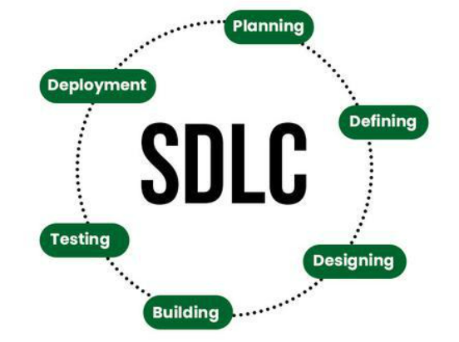
Software Development Life Cycle
Definition :-
Software development life cycle (SDLC) is a structured process that is used to design, develop, and test good-quality software. SDLC, or software development life cycle, is a methodology that defines the entire procedure of software development step-by-step.
Stages of the Software Development Life Cycle:-
SDLC specifies the task(s) to be performed at various stages by a software engineer or developer. It ensures that the end product is able to meet the customer’s expectations and fits within the overall budget. Hence, it’s vital for a software developer to have prior knowledge of this software development process.

Slide 3
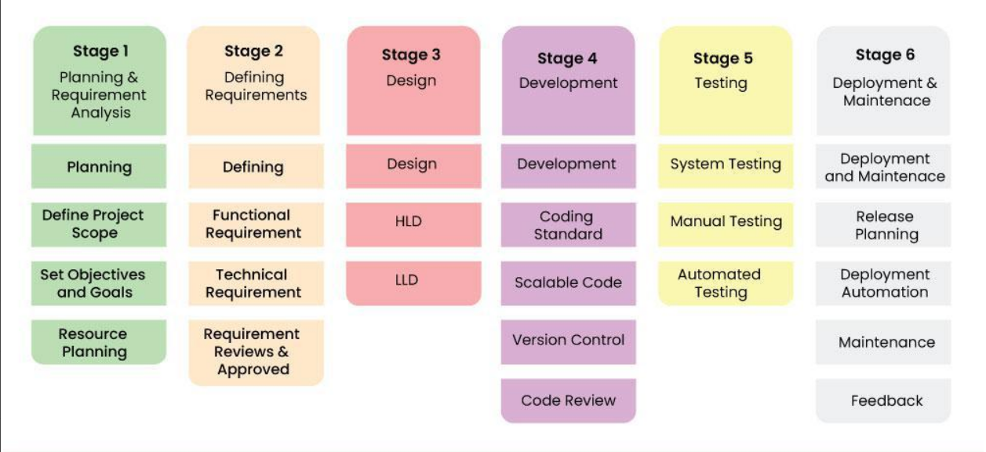

Slide 4
Software Process Models
A software process model is an abstraction of the software development process. The models specify the stages and order of a process. So, think of this as a representation of the order of activities of the process and the sequence in which they are performed.
RAD(Rapid Application Development) Model:-
RAD Model or Rapid Application Development model is a software development process based on prototyping without any specific planning. In RAD model, there is less attention paid to the planning and more priority is given to the development tasks. It targets at developing software in a short span of time.
SDLC RAD modeling has following phases
Business Modeling
Data Modeling
Process Modeling
Application Generation
Testing and Turnover

Slide 5
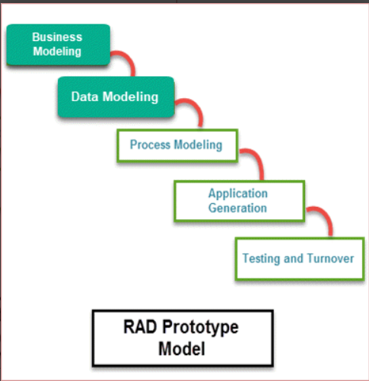
RAD Model or Rapid Application Development model is a software development process based on prototyping without any specific planning. In RAD model, there is less attention paid to the planning and more priority is given to the development tasks. It targets at developing software in a short span of time.
SDLC RAD modeling has following phases
Business Modeling
Data Modeling
Process Modeling
Application Generation
Testing and Turnover

Slide 6
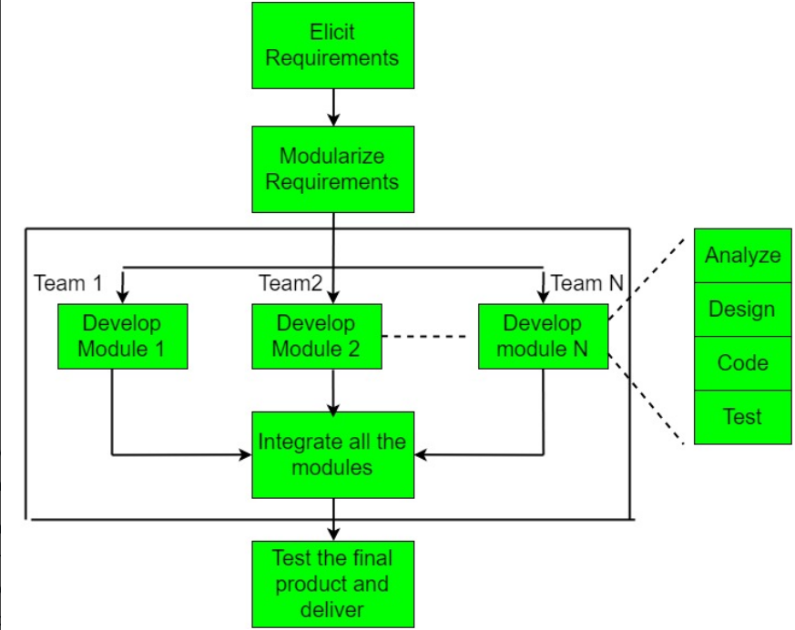

Slide 7
Different Phases of RAD Model:-
There are following five major phases of Rapid Application Development Model
RAD Model Phases :- Activities performed in RAD Modeling
Business Modeling :-On basis of the flow of information and distribution between various business channels, the product is designed
Data Modeling:- The information collected from business modeling is refined into a set of data objects that are significant for the business
Process Modeling:-The data object that is declared in the data modeling phase is transformed to achieve the information flow necessary to implement a business function
Application Generation:-Automated tools are used for the construction of the software, to convert process and data models into prototypes
Testing and Turnover:-As prototypes are individually tested during every iteration, the overall testing time is reduced in RAD.

Slide 8
Advantages of RAD Model:-
Flexible and adaptable to changes
It is adaptable and flexible to changes
It is useful when you have to reduce the overall project risk
It is easier to transfer deliverables as scripts, high-level abstractions and intermediate codes are used
Due to code generators and code reuse, there is a reduction of manual coding
Due to prototyping in nature, there is a possibility of lesser defects
Each phase in RAD delivers highest priority functionality to client
With less people, productivity can be increased in short time
Disadvantages of RAD Model:-
It can’t be used for smaller projects
Not all application is compatible with RAD
When technical risk is high, it is not suitable
If developers are not committed to delivering software on time, RAD projects can fail
Reduced features due to time boxing, where features are pushed to a later version to finish a release in short period

Slide 9

Be it Andhra Pradesh or Telangana, the soul is Telugu.
First they ignore you, then they laugh at you, then they fight you, then you win. -Mahatma Gandhi
Life is like riding a bicycle. To keep your balance, you must keep moving. -Albert Einstein

